Slide 1
TURKS AND CAICOS ISLANDS
Roundtable Discussion on: Green Budgeting Practices
Challenges and Opportunities in the Caribbean region

Slide 2
Climate Change Conversations
Essentially not new
Significant emphasis following 2017 tropical cyclones
  UNDP Study to Support the Recovery Process for the Turks and Caicos Islands (MAY 2018)]

Slide 3
Major Recommendations from the UNDP 2018 Study
Significant investment in Disaster risk management and Environmental management but figure not quantifiable in the accounting system
  A total of 138 development codes and 119 non‐development codes were identified with climate dimensions. There is a broad constituency of interest in delivering the outcomes of disaster risk reduction and climate response in the TCI.
  The period under review (2014 to 2016) witnessed an increase of 23.4% in actual expenditure for programmes with a climate dimension.

Slide 4
GOVERNMENT POLICY
Government was in the process of finalizing Vision 2040 Document
The five (5) high level outcomes or Sustainable Development Dimensions (SDDs) are:
  High national income and wealth - SDD 1
    Replaced the information above (Robust and climate resilient infrastructure- SDD 1;)
  A socially cohesive society – SDD 2;
  Healthy, natural environment, heritage and cultural assets - SDD 3;
  Citizen security – SDD 4; and
  Good governance – SDD 5

Slide 5
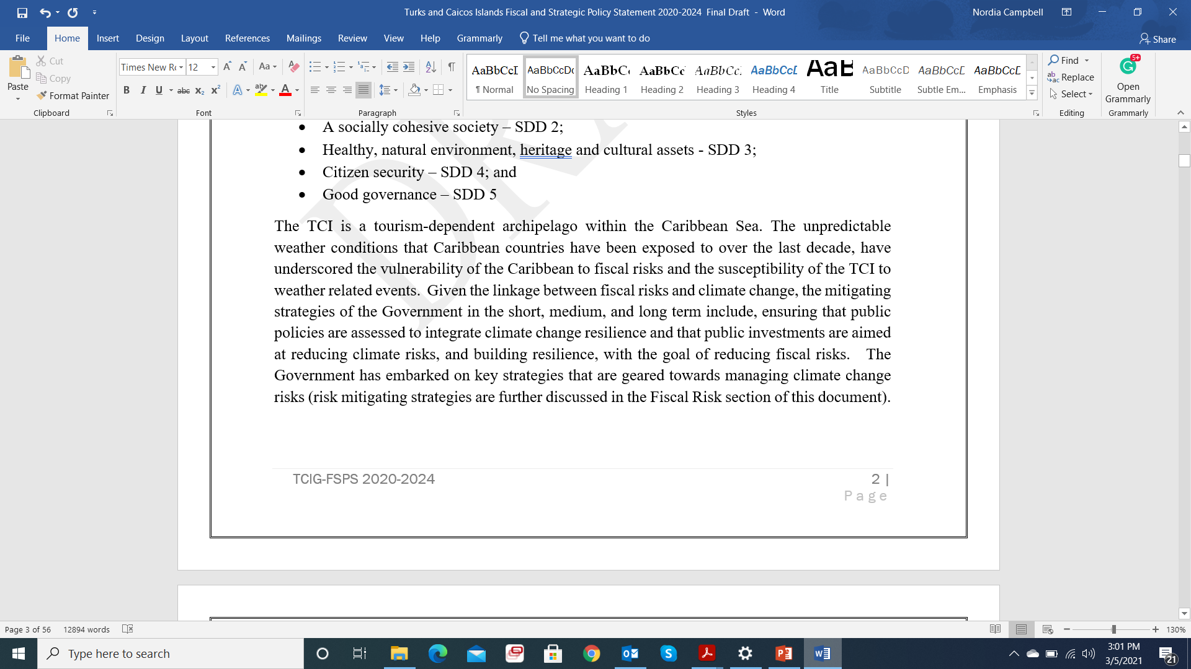
GREEN BUDGET INTERVENTIONS
MTEF(2020-21)

Slide 6
DIRECT INVESTMENT IN PROTECTION OF THE ENVIRONMENT AND CLIMATE CHANGE RISK REDUCTION
Allocations are sometimes dependent on the personalities
Cross cutting expenditure not captured

Slide 7
MAJOR INVESTMENT IN PROTECTION OF THE
ENVIRONMENT AND CLIMATE CHANGE RISK REDUCTION
    Rebuilding the Climate Resilient Seaport(Financed from Consolidated Fund) > $41m
    Several other smaller projects funded

Slide 8
OTHER INTERVENTIONS
  Budget Office invited the Director of DECR and Director Disaster Management and Emergency Services to sit as panelists in budget challenge and funding decision committees to assist with identifying gaps in green budgeting.
      Identification of projects that are not properly assessed
      Identification of projects that should be given priority funding
      Some ministries are not receptive of the inclusion
      Robust allocation to the DECR
Issuance of the Capital Expenditure call circular to allow time for environmental impact assessments to be completed on major projects
  Though the circular was issued early, the intended goals were not necessarily achieved.

Slide 9
CHALLENGES
Financing
Chart of account has not been adjusted to effectively show the direct investments in climate change
COVID-19 has set back implementation plans

Slide 10
OPPORTUNITIES
Financing – PPP Financing Model a potential option
Training of New Administration - Green Budgeting
Adjustment of the chart of accounts

Slide 11
THANK YOU!

