Slide 1

Green Budgeting
Ministry of Economy
Fiji
An Overview of Fiji’s Experience With

Slide 2
CONTENTS
Green Budgeting
Fiji’s perspective on fundamentals for green budgeting
Examples of Green Budgeting
Key examples of green budgeting in Fiji
Future Plans
New and innovative work planned for green budgeting
Q & A
Interactive Session

Slide 3
Green Budgeting
Ministry of Economy
Fiji
Fiji’s perspective on fundamentals for green budgeting

Slide 4
Building Blocks of Green Budgeting
Enabling Budgetary Governance Framework
Strong Strategic Framework
National strategic priorities and objectives relating to the environment and climate are clearly set out so as to help inform fiscal planning.
A modern budgetary framework provides a strong enabling environment for green budgeting.
4
1
Building Blocks of Green Budgeting
Reporting to Facilitate Accountability and Transparency
3
2
Tools for Evidence Generation and Policy Coherence
Adequate reporting to relevant stakeholders (e.g. parliament and civil society) facilitates scrutiny of the quality and the impact of green budgeting.
Requires a robust consortium of fiscal planning tools that help gather evidence on how budget measures impact environmental and climate objectives.

Slide 5
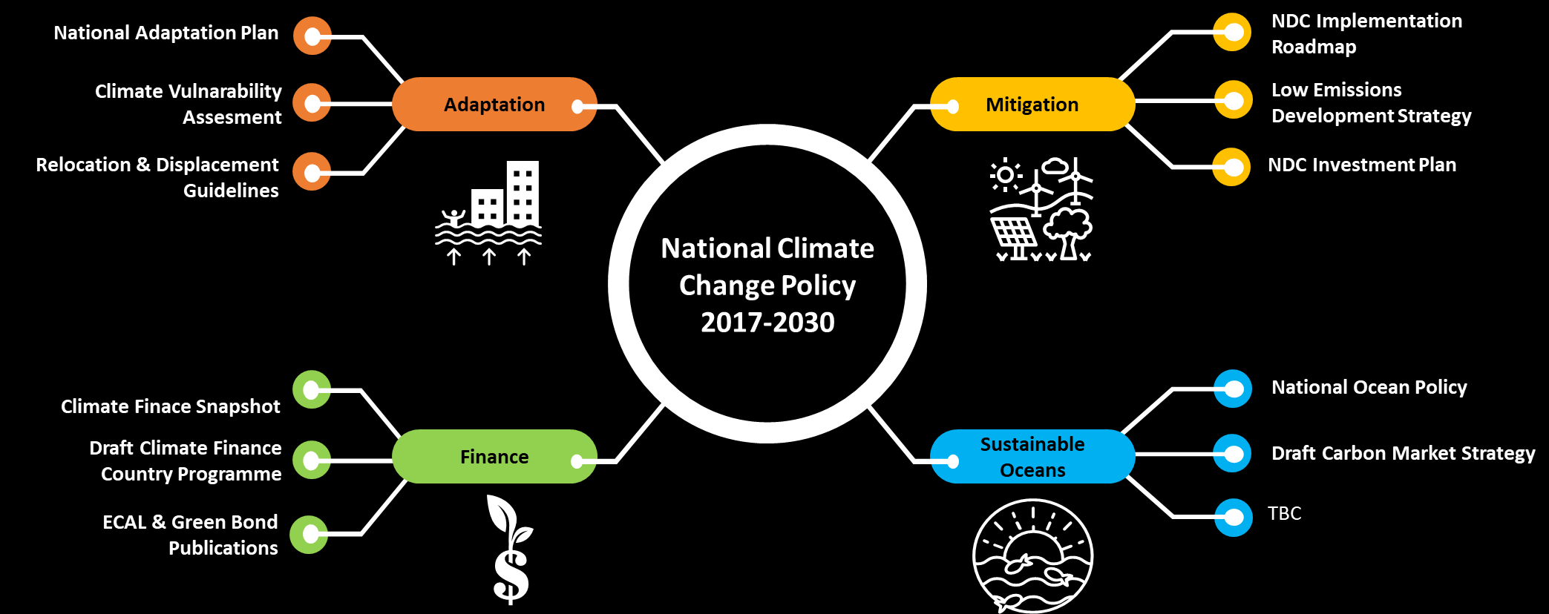
Strong National Policies for Green Budgeting
5-Year and 20-Year
National Development Plan
Environment Policies and Plans

Slide 6
Institutional Strengthening
Embedded Climate Change Division into the Ministry of Economy
  Strong institutional arrangement to place climate change considerations at the heart of development planning.
Changed financial year from 1 January – 31 December to 1 August – 31 July
  Fiji’s cyclone season is from November to April
  Improves fiscal planning for disaster risk reduction and reduce unforeseen fiscal shock
Strategic Expenditure Planning
Established contingency funding lines
  Prime Minister’s Disaster Relief Fund
  Stand-by Loan for Disaster Recovery and Rehabilitation – Japan International Cooperation Agency (JICA)
  Climate Relocation of Communities Trust Fund
6

Slide 7
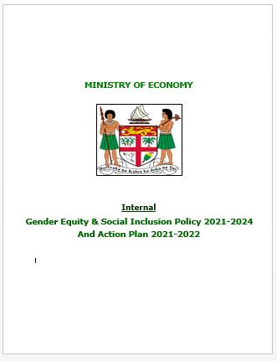
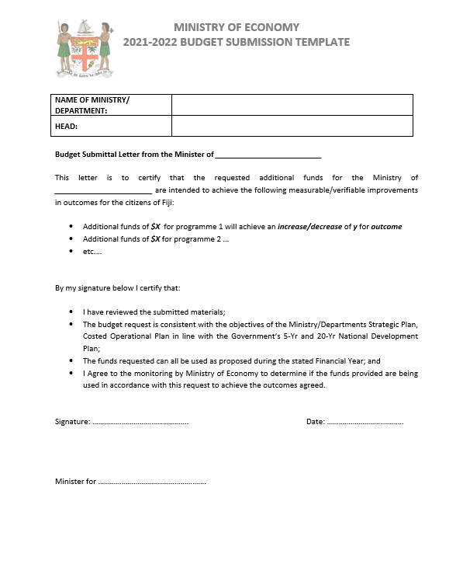
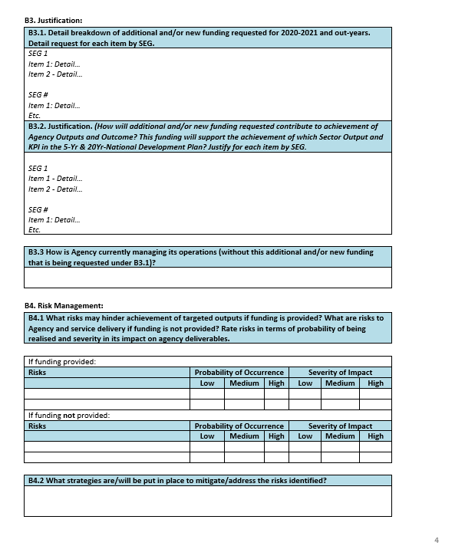
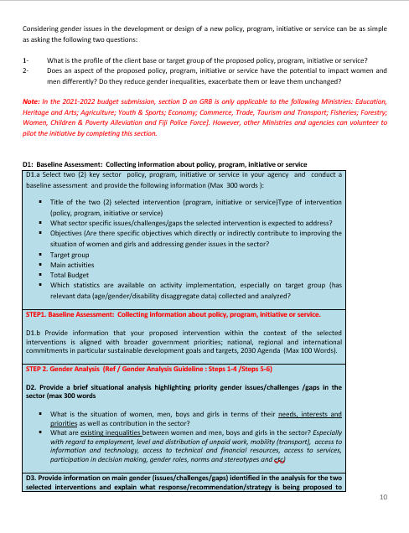
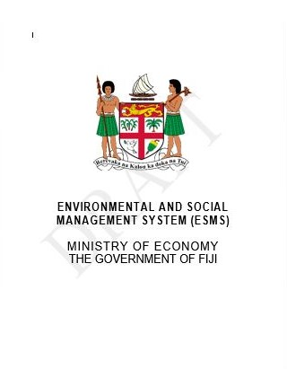
Approaches for Green Budgeting and Policy Coherence
Bottom up approach to engraining green budgeting in budget formulation process
  Budget submission templates require line Ministries to rationalize and align their budget request to national climate ambitions and environmental conservation goals.
Ministries also required to engrain risks using a hierarchy system – risk informed development incorporating climate and environment risks.
Trialing Gender Responsive Budget (GRB) with 9 Ministries – gender centric rationalization for programmes and projects.
The Ministry of Economy is in the process of developing its internal:
  Environment and Social Management Safeguards (ESMS)
  Gender, Equity and Social Inclusion (GESI) Policy
7

Slide 8
Examples of Green Budgeting
Ministry of Economy
Fiji
Key examples of green budgeting in Fiji

Slide 9
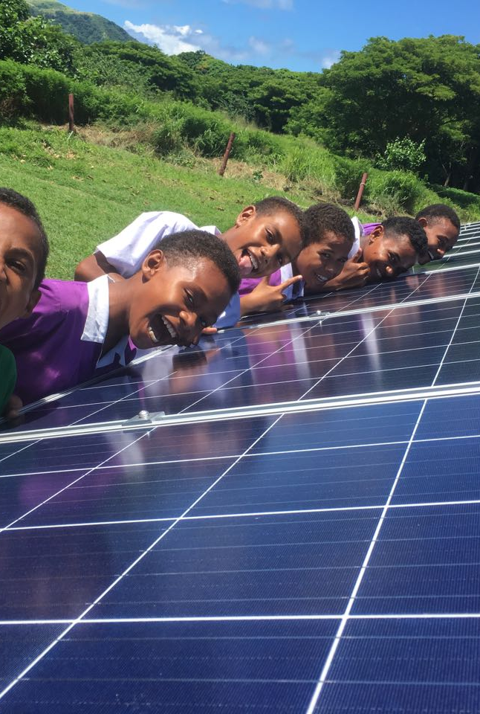
Environment and Climate Adaptation Levy (ECAL)²
  Flagship fiscal mechanism for Fijian Government to finance its climate and environment projects since 2017-2018.
  Is made up of a consortium of a consortium of taxes on all vehicle imports, selected luxury items, plastic bags, super yachts and income over FJ $270,000.
  Generates an average of FJ $120 million per year (pre COVID-19).
  Guided by the ECAL Act (2015) with over 75 projects from Government National Budget qualifying for ECAL funding every year.
The following are key fiscal policy measures associated with green budgeting:
  Tax holidays for individuals/companies seeking to set up bio-fuel production;
  Tax holiday and subsidies for electric charging stations;
  Tax holiday on new renewable energy generation or cogeneration;
  Duty free importation of renewable energy goods; and
  Reduced duty on electric busses.
Capital market financing through Green Bonds
  FJ $100 million worth of bond issuance.
  Great success – all tranches/issuances were oversubscribed.
  First small island developing state, only the 3rd country in the world to issue such a bond.
  Good optics but need to lower cost of issuance to make real sense.
2. https://www.economy.gov.fj/images/CCIC/uploads/ClimateFinance/ECAL-Bulletin-01-2018.pdf
9

Slide 10
Future Plans for Green Budgeting
Ministry of Economy
Fiji
New and innovative work planned for green budgeting

Slide 11
Developing Climate Budget Tagging – with United Nations Development Programme
  In the process of finalising climate change and environment codes in the Chart of Accounts as part of Fiji’s Public Financial Management Reform Programme.
  In the process of developing climate and environment typologies to better ascertain and demarcate climate and environment expenditure from normal development expenditure.
  Crucial to understand how the incremental cost of climate sensitizing development can be identified to avoid green washing budget expenditure.
Developing procedures and templates to identify climate relevant expenditure for infrastructure projects – with Asian Development Bank.
The upcoming Climate Change Bill¹ (available online) will mandate climate risk reporting for all Government agencies and voluntary reporting for private sector.
Working on Ministry of Economy being accredited to the Green Climate Fund to undertaking blended financing with current fiscal expenditure on climate action and environmental conservation.
11
1. https://www.economy.gov.fj/images/CCIC/uploads/BILL/Fiji_Climate_Change_Bill-Draft-2-for-Public-consultation-18-November-2020.pdf

Slide 12
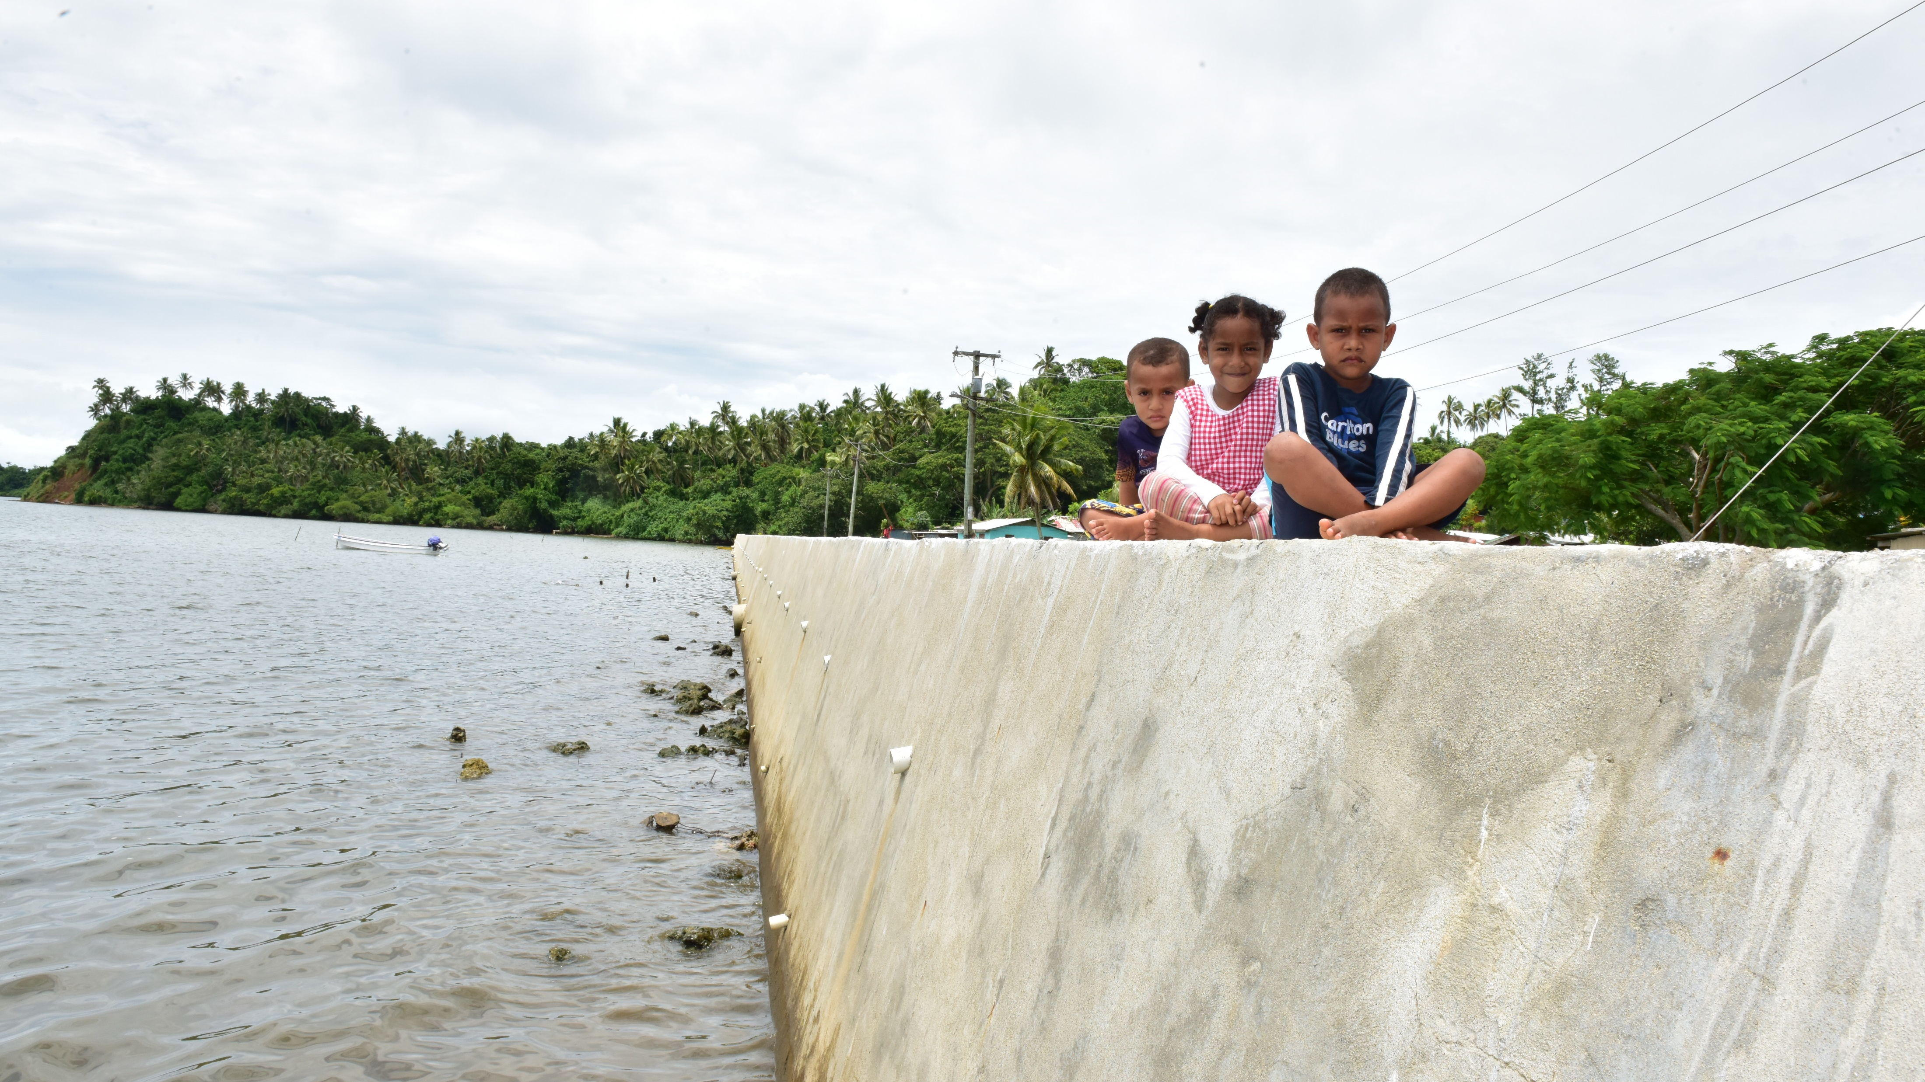



THANK YOU!
Ministry of Economy
370 Victoria Parade
Suva, Fiji
shiri.gounder@economy.gov.fj
vineil.narayan@economy.gov.fj
+679 330 7011

