Slide 1

Climate Change Mainstreaming in Planning and Budgeting

Slide 2
Climate change integration in PFM
MTEF/Budget proposals
CC prioritization at budget formulation
Budget coding
Expenditure Reporting
Expenditure Analysis
Integrated Climate Change Financing Framework (CCFF)
Policy briefs
Civil society
Parliament
Building consensus
Enabling integration in the budget
Improved CC budget decisions and accountability
Building the evidence
CPEIR
Climate Change Budget Integration Index (CCBII)

Slide 3
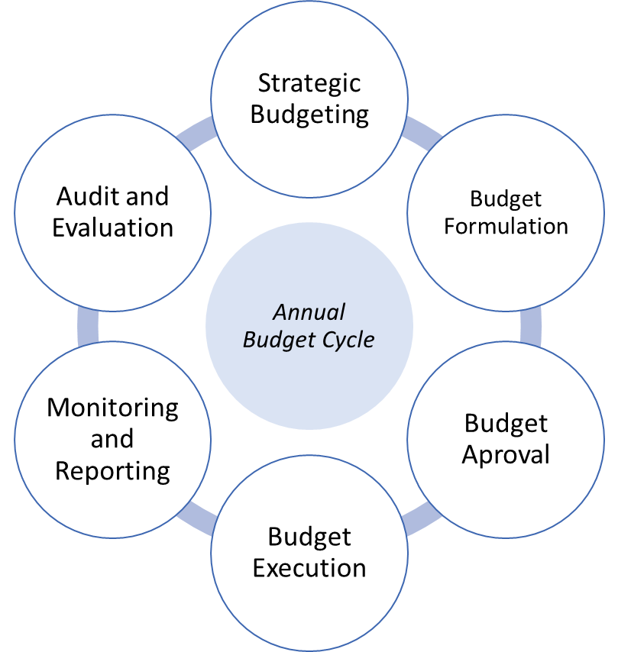
Climate Change Finance Reforms in Asia Pacific
Climate Change Financing Frameworks- Nepal, Bangladesh, Pakistan, Indonesia
Climate Change integrated into MTEF Bangladesh in MTBF Pakistan
CC and annual budget policies- Bangladesh, Indonesia, Nepal, Pakistan
Climate Public Expenditure and Institutional Reviews (CPEIRs)- Cambodia, Vietnam
Climate Change Audit- Bangladesh
Budget Circulars- Cambodia, Tonga, Nepal, Bangladesh
Climate Change Benefit Analysis- Cambodia, Thailand
Risk Resilience Framework Tonga
Collaborative research Indonesia and Cambodia
Climate Budget Tagging- Bangladesh, Nepal, Indonesia, Pakistan
Formalisation of Expenditure Reporting- Indonesia, Nepal, Pakistan- (Economic Survey, Controller General reports, Climate Finance reports)
Parliamentary engagement in CC budget scrutiny- Bangladesh, Nepal, Pakistan;
Citizen’s Climate Budgets- Cambodia, Nepal

Slide 4
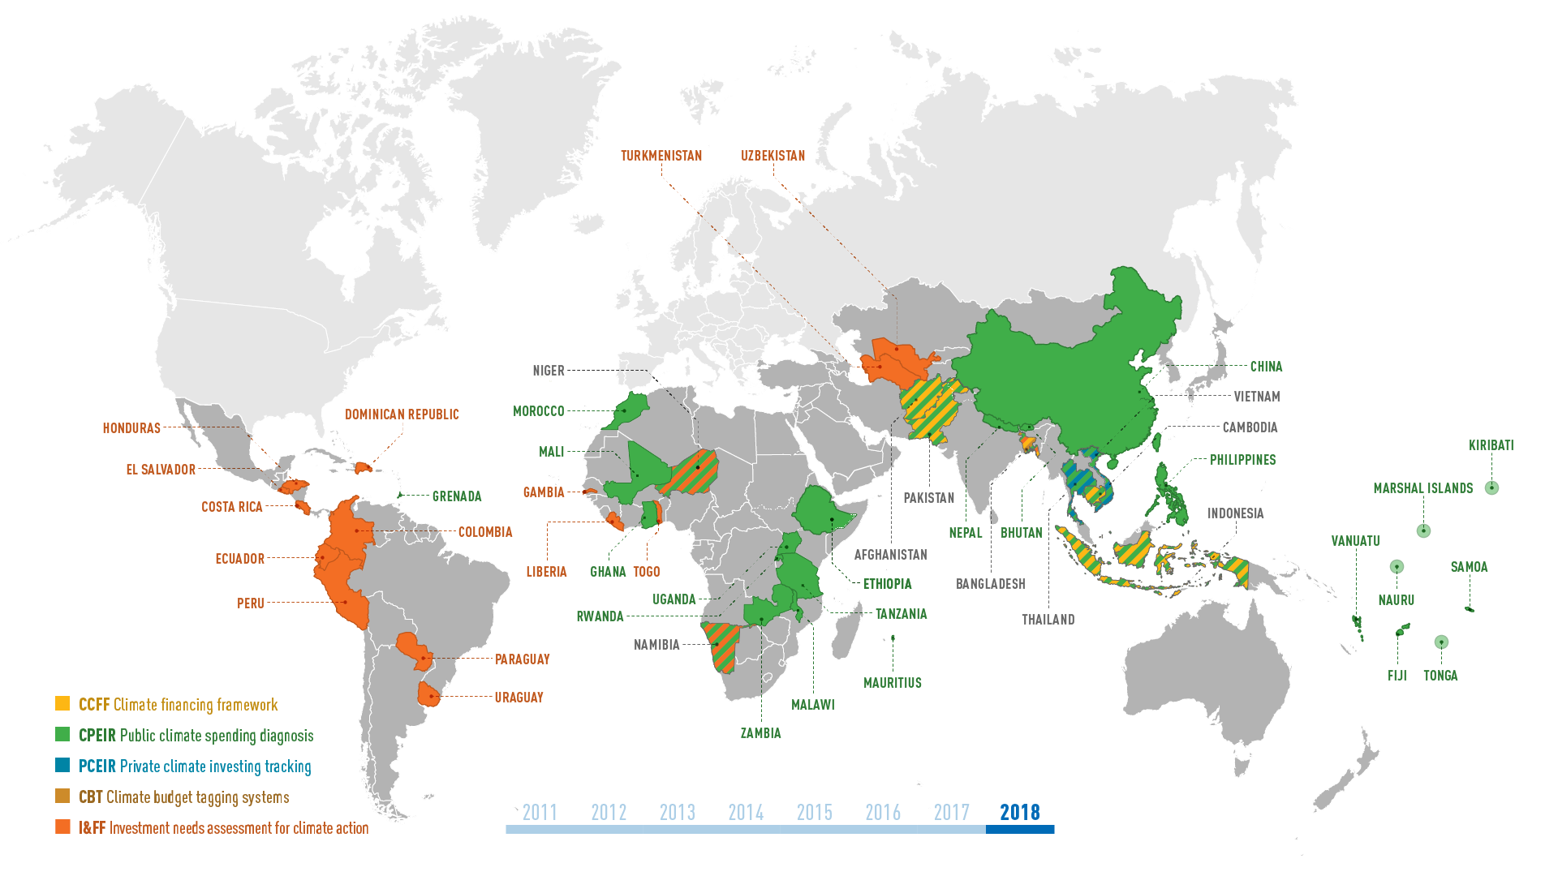

Slide 5
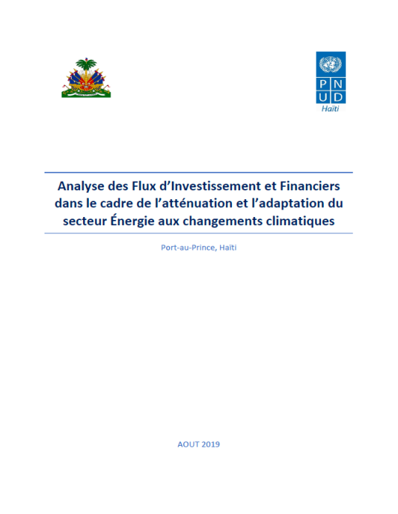
Selected examples from LAC region. Haiti
Haiti carried out Investment and Financial Flows (I&FF) assessments to assess financial requirements and policies to implement their National determined Contributions (NDC)
Work based on:
The assessments focused on the sectors energy and agriculture
The assessments were carried out with special dedication of a national expert team, working closely with both ministries
The work is embedded and builds on relevant national processes and strategies, e.g. the National Growth & Poverty Reduction Strategy and the National Anti-Desertification Action Plan.
Notes:
Esta distribución fue efectuada con base en la relevancia climática asignada a los gastos identificados para el cambio climático de cada uno de los países; respecto a dicho gasto. Para el momento en que se compilaron los datos regionales Colombia aún no presentaba información cuantificable

Slide 6
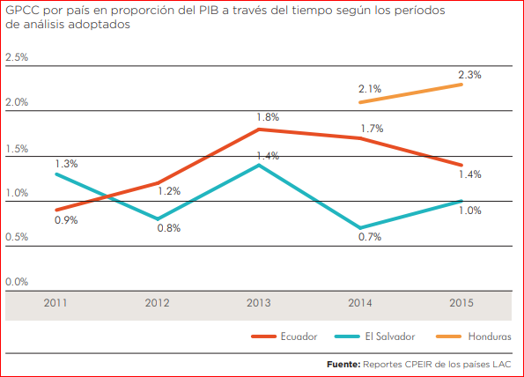
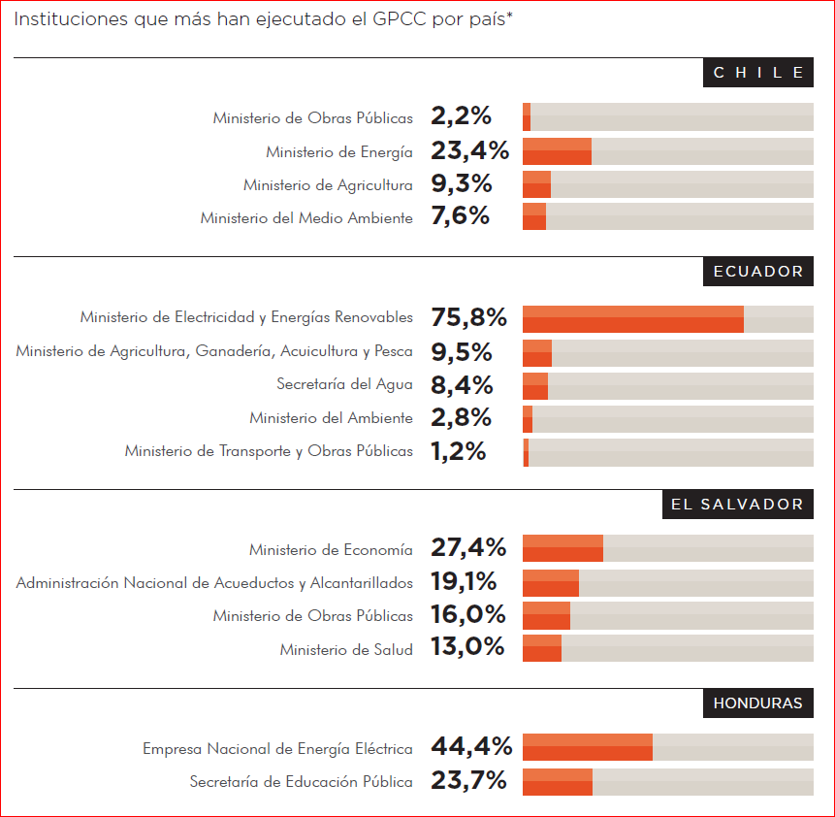
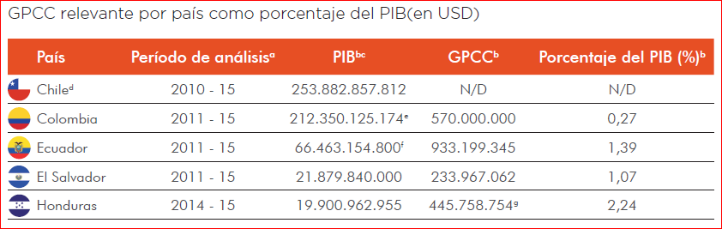
Selected examples from LAC region. Experiences at Honduras, Colombia, Chile, Ecuador and El Salvador (2018 - 2019)
Main findings:
Spending related to climate change it is not framed according to the relevant policies like NDC implementation.
Improvement of spending efficiency to achieve the climate goals (NDC), should be considered as cross-cutting in national development strategies.
Evaluation of effectiveness implies monitoring of climate spending positive impact for development needs in the country.
GPCC: Public Spenditures in Cliamate Change (Spanish acronym)
http://www.latinamerica.undp.org/content/rblac/es/home/library/environment_energy/experiencias-en-la-aplicacion-de-la-metodologia-de-analisis-del-.html

Slide 7
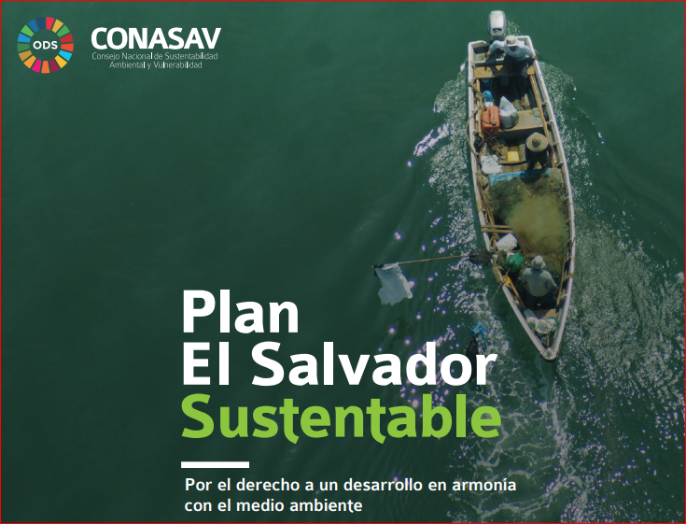
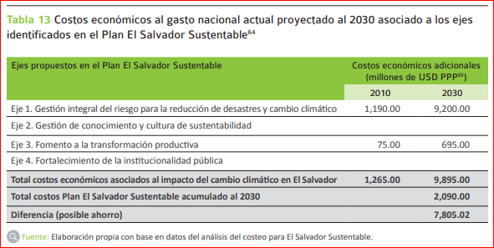
Selected examples from LAC region. El Salvador
Work based on:
Institutional management of climate finance priorities / NDC governance.
Study of public spending on climate change (CPEIR)
NDC costing (I&FF) at five NDC strategic sectors.
Prioritization of strategic investments to minimize climate damage/risks (Critical Investment Strategy 2050).
Climate financing strategy, including governance and monitoring systems to be implemented.
https://www.ndcs.undp.org/content/ndc-support-programme/en/home/impact-and-learning/library/plan-el-salvador-sustentable.html
Notes:
Esta distribución fue efectuada con base en la relevancia climática asignada a los gastos identificados para el cambio climático de cada uno de los países; respecto a dicho gasto. Para el momento en que se compilaron los datos regionales Colombia aún no presentaba información cuantificable

Slide 8
Selected examples from LAC region. Ecuador and Chile
NDC Energy sector mitigation targets adjusted, disaggregated and costed (+ S-S cooperation).
Climate finance budget institutional frameworks strengthened with tools and methodologies.
Track climate spending (public and private) and climate financial flows.
Monitor efficiency of public policies associated with NDC
Strength capacities for the generation of NDC investment strategies to accelerate NDC implementation with I&FF
opportunities and limitations to incorporate climate change in the process of country's public spending
Tagging system and piloting of monitoring & efficiency platform for NDC investments
Costing of NDC – LTS – 2050 neutrality strategy for Energy sector
CPEIR
I&FF
PCEIR
Climate Budget Tagging / monitoring
Public & Private
PAST /
BASE LINE
PRESENT /
REPORTING
FUTURE /
FORCAST
Data to support NDC Climate Finance Strategy
Notes:
Esta distribución fue efectuada con base en la relevancia climática asignada a los gastos identificados para el cambio climático de cada uno de los países; respecto a dicho gasto. Para el momento en que se compilaron los datos regionales Colombia aún no presentaba información cuantificable

